Slide 1
Date a scientist capstone project codecademy
Submitted by: Gayathri Rajagopalan
Date: 14 June 2019
Pro-intensive course:
Machine Learning Fundamentals

Slide 2
TABLE OF CONTENTS
Initial analysis of data and cleaning
Features to be analyzed
Questions
Graphs and algorithms used
Conclusion

Slide 3
INITIAL ANALYSIS & data cleaning
From the profiles data set that was given, it was observed that many features were not relevant for analysis and hence they were removed
The following features/columns were retained and any null/missing values were removed:
Age, body type, diet , drinks, drugs, height, smokes
Some of these columns were mapped to numeric values including the following: body type, diet, drinks, drugs and smokes
The user age base is right skewed, with the mean age around 33 years
Analysis of the body type feature reveals that users tend to be on the fitter side

Slide 4
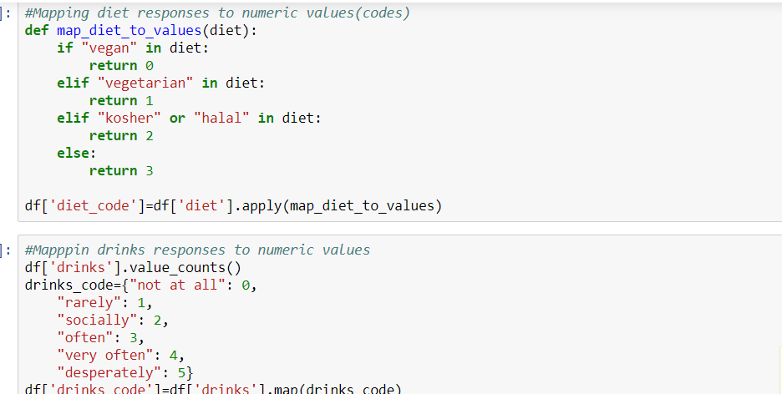
MAPPING COLUMNS TO NUMERIC VALUES

Slide 5
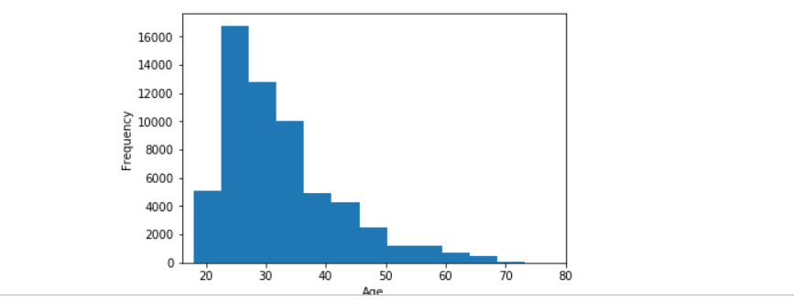
Age histogram

Slide 6
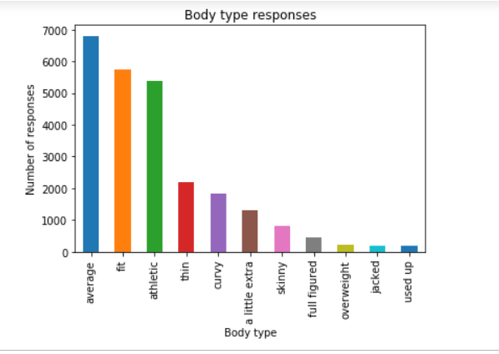
Body type responses histogram

Slide 7
Questions
Question1: Can we predict age using diet, lifestyle(smoking, drinking, drug habits) and body type to predict age?
Question 2: Can we use diet, lifestyle information(drinking/drugs/smoking habits) and age to predict body type?

Slide 8
Question 1
Question1: Can we predict age using diet, lifestyle(smoking, drinking, drug habits) and body type to predict age?
Approaches used:
Multiple linear regression model
K Neighbors Regressor Model

Slide 9
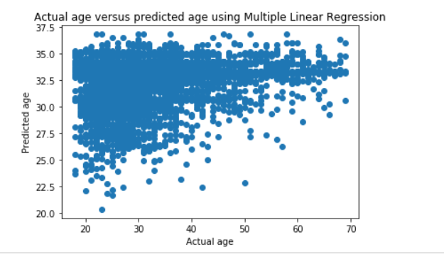
ACTUAL AGE VS PREDICTED AGE USING LINEAR REGRESSION MODEL

Slide 10
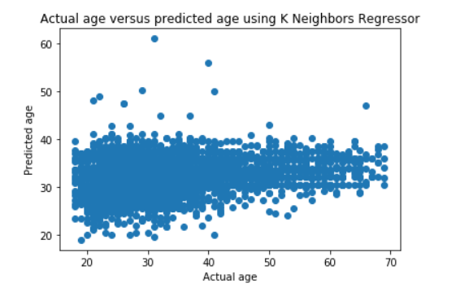
ACTUAL AGE VS PREDICTED AGE USING K NEIGHBORS MODEL

Slide 11
Question 2
Question 2: Can we use diet, lifestyle information(drinking/drugs/smoking habits) and age to predict body type?
Approaches used:
K Nearest Neighbors
Support Vector Machines

Slide 12
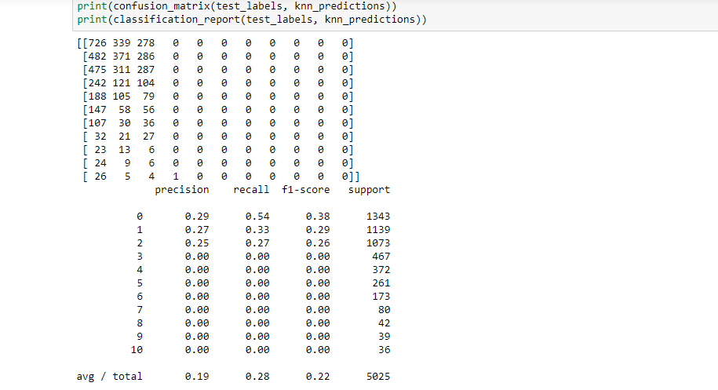
K nearest neighbors(classification and confusion matrix)

Slide 13
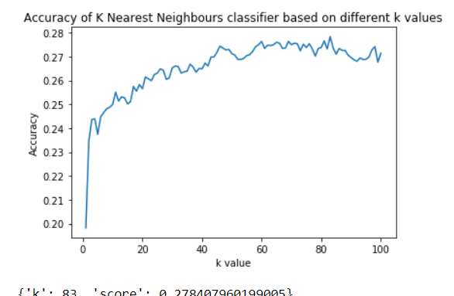
K nearest neighbors(contd.)

Slide 14
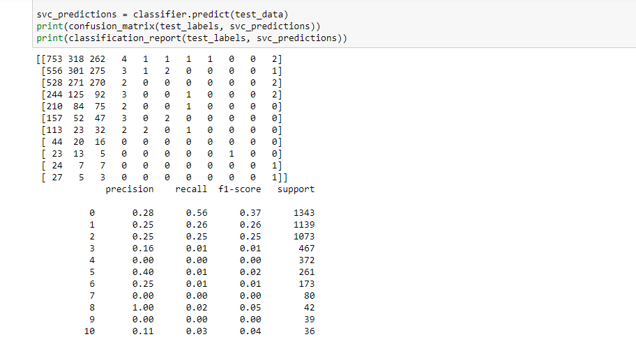
Support vector machines(classification and confusion matrix)

Slide 15
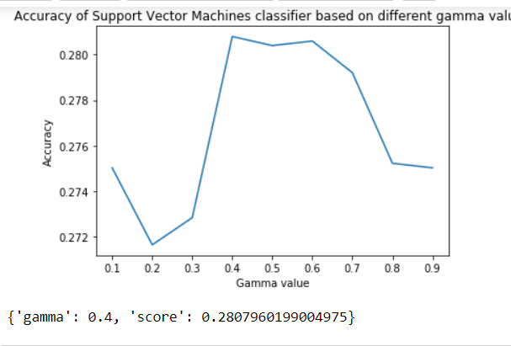
Support vector machines(contd.)

Slide 16
Observations and inferences
The accuracy of both models is around 0.28 and is too low to be considered
Time to run the models is around 20 seconds
Initial assumptions of predicting age and body type based on the selected features may need to be discarded
Initial hypothesis may have been generic and further exploration/cleaning of data may be required

